Slide 1

Module 4 – SMA-X Knowledge Management
Jan 2018
Notes:
[STANDARD SLIDE: L300 (animated)]
You can change out the photo with any image from Getty Images in DropBox.
If the main title is shorter, you can make the font larger.
You may have to move the title text around depending on the photo. Make sure the text is readable against the background photo.
You can change the background color for the rectangle in the bottom-right corner to look better against the background. Choose a Micro Focus color at 25% transparency.
=========================
Note to Narrator or Reader: [PRESS] indicates press the Page Down key to show the animation
=========================
Hello and Welcome to the [COURSE_NAME] Technical Overview Training, Level 300.
In this course you’ll gain a high-level understanding of the essentials of [PRODUCT_NAME].
[PRESS] If you want to download this presentation and save it on your own system, click the Tools & Help icon in the bottom-right corner of your window and select Download.
Or, if you want to access the PPT slides and speaker notes for future reference, go to the Attachments tab in your window click to download the presentation.

Slide 2
Objectives
After completing this module, you should be able to:
Describe the components of Knowledge Management
Understand how to use Hot Topic Analytics
Monitor Ask Friends/Help Friends
Create and Publish Knowledge Articles
Create and Publish IT News
Describe how to restrict access to Articles

Slide 3
Overview

Slide 4
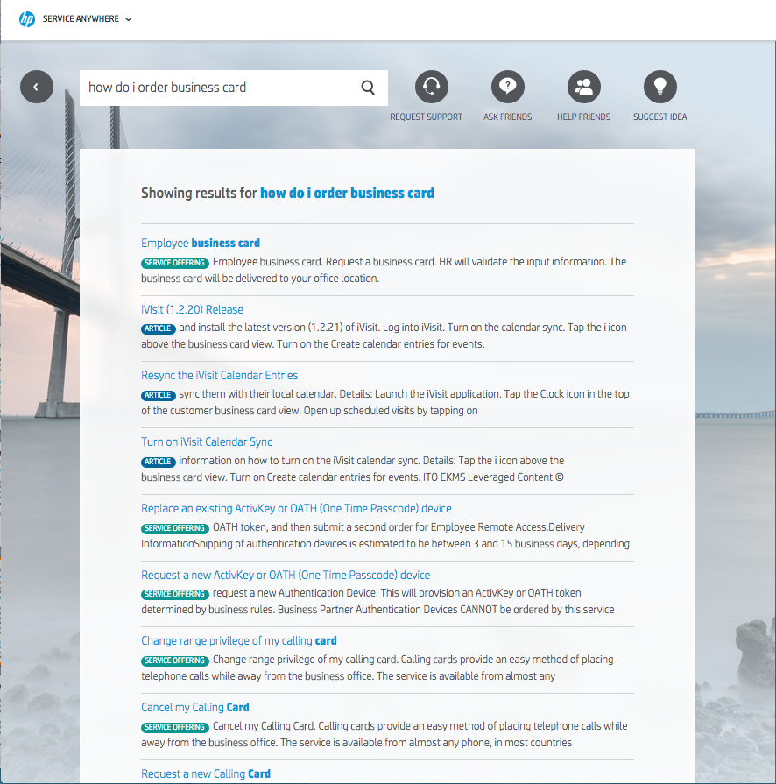
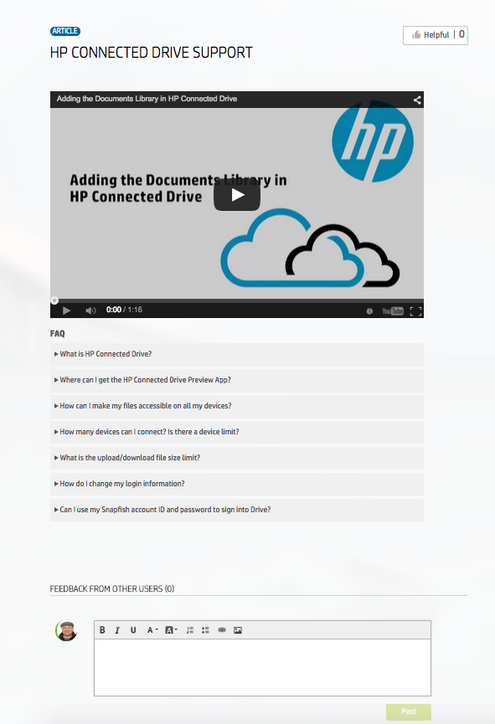
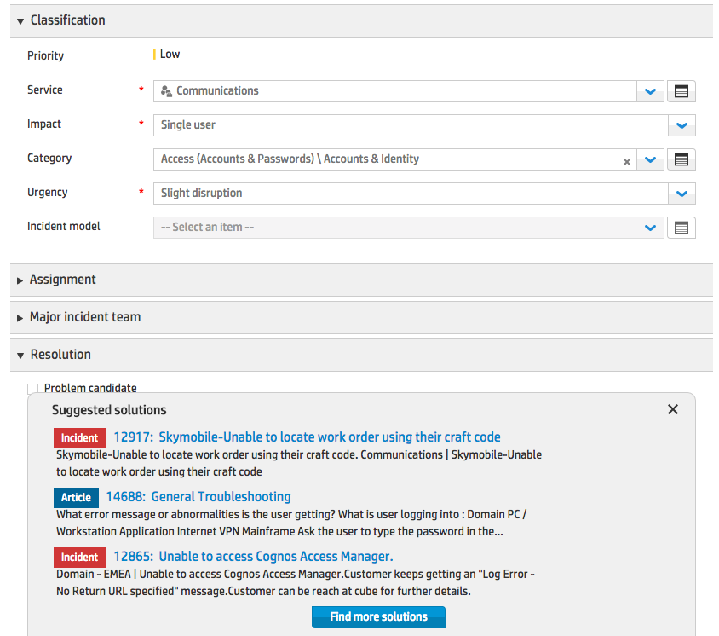
Knowledge Management
Knowledge is used by both ESS Users and IT Agents to solve issues
Full-text search capabilities
Self Service search of externally published articles
IT user search of knowledge documents and Service Requests, Incidents, and Problems
Capture, Structure, Reuse, and Improve your knowledge
Convert Service Desk solutions into re-usable knowledge
Use knowledge results to solve current investigations
Publishing workflow for knowledge documents with publication periods and entitlement
End users comments on Knowledge Articles, report on knowledge vote, view and usage provide valuable feedback
Leverage other knowledge sources through document import or on-premises crawling
Historical knowledge from other systems, sample articles and connectors (Sharepoint…)
Notes:
Create Offerings to handle Hot Topics
Drive better automation by defining Service and Support offerings where they are most needed
Knowledge View and Use reporting
Track the articles that are most/least read and used as solutions
News and Article Publication Periods
Define publication start and expiration dates for all knowledge content
Service based Article Publishing and Consumption Provide business users with better information specific to services of interest

Slide 5
Knowledge Management Components
Articles
Knowledge contributors can add, update, and move knowledge articles through certain phases of the workflow process. Knowledge publishers can publish or remove articles to/from the Self-Service portal.
News
Knowledge contributors can add, update, and move news articles through certain phases of the workflow process. News articles can be alerts for the Self-Service portal users about critical issues, and other important or general alerts. They are displayed in the widgets panel of the Self-Service portal
Q&A Moderation
Knowledge contributors can moderate questions and answers from Self-Service portal users.
Hot Topic Analytics
Knowledge contributors can analyze questions and requests submitted by Self-Service Portal users. They can also analyze the types of information users are looking for.

Slide 6
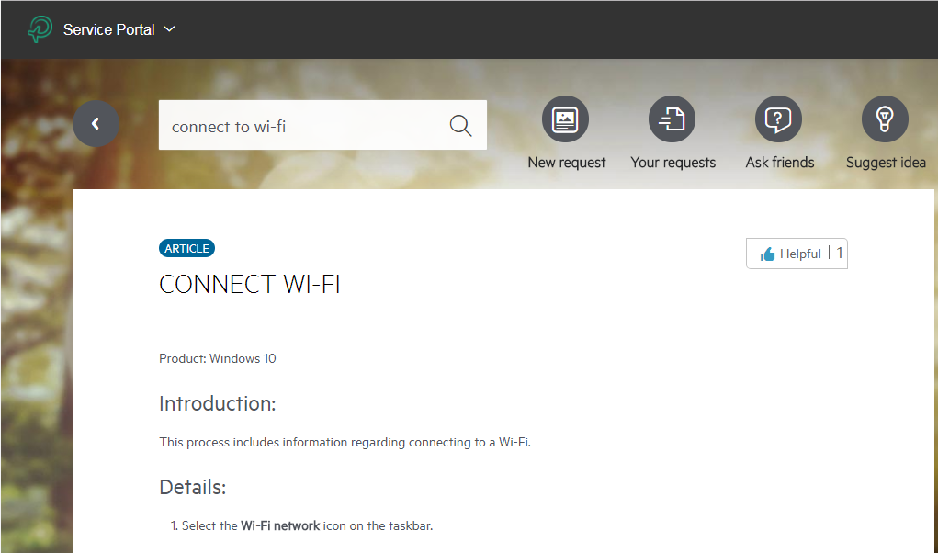
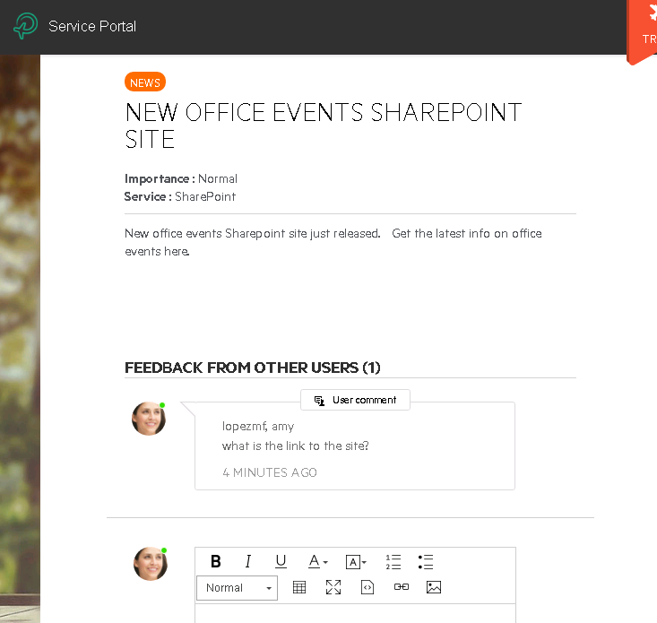
Knowledge Article – ESS Rating and Feedback
If an ESS User finds an article helpful, click the Helpful button. This increases the rating of the article for other user searches.

Slide 7
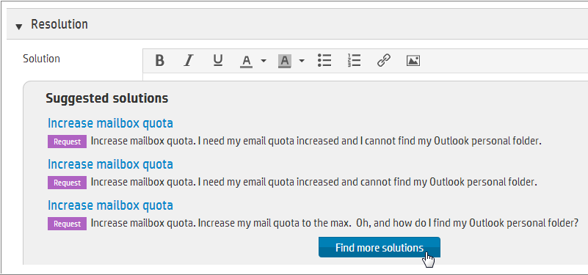
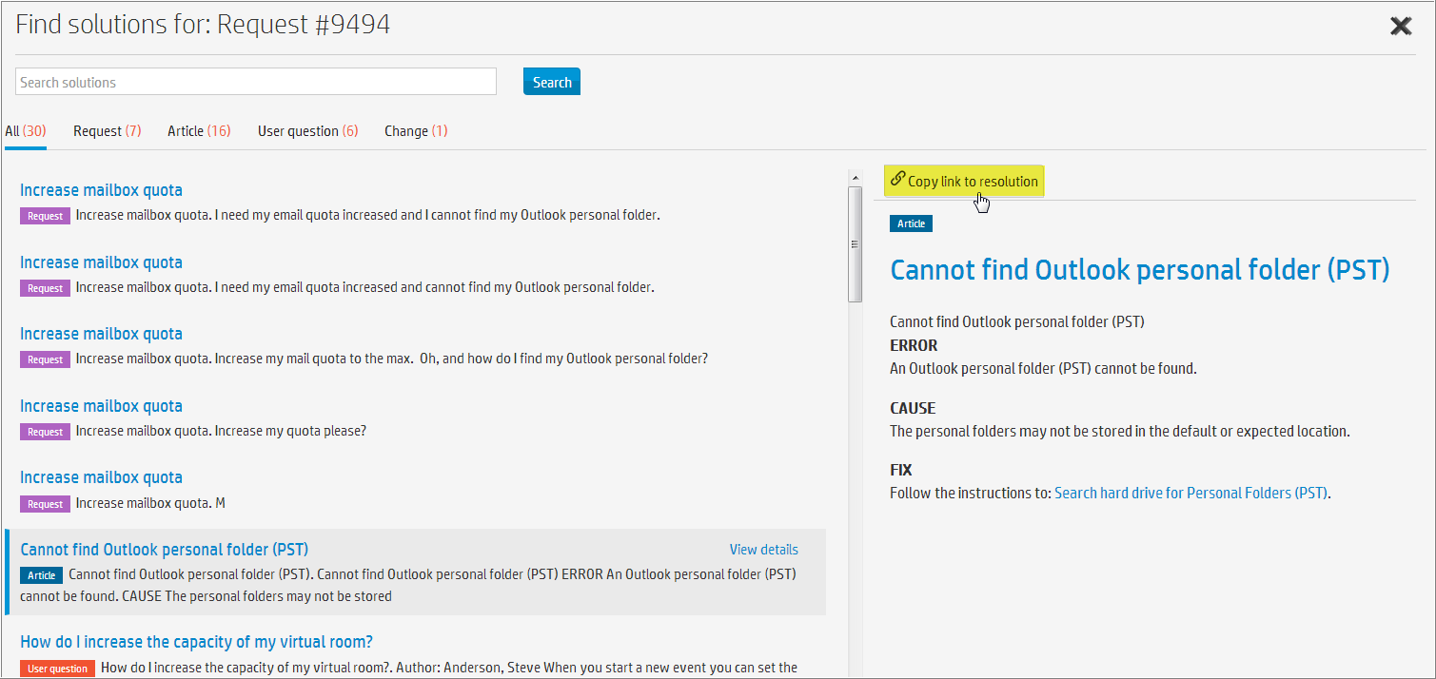
Proactive Suggested Solutions
Available to Agents working on a ticket (Request, Incident, Problem, Change, Release)
Shows suggested solutions based on the current content
Single result set spans all types of knowledge records – articles, forum posts, tickets, on premise index knowledge, ….
Content can be previewed in place
Apply solutions by:
Linking to related tickets
Copying solutions from tickets
Copy or link to solution text in articles, external content, etc.

Slide 8
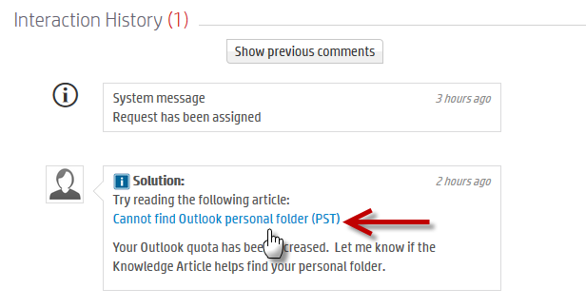
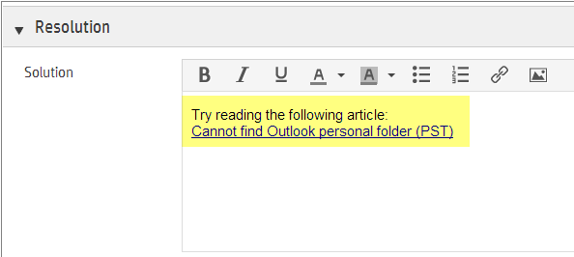
Module Integration Providing Solutions
More Solutions
The agent can link an article to provide steps to the resolution section to suggest it to the user
Similar requests
Questions
Link to related incidents

Slide 9
Hot Topic Analytics

Slide 10
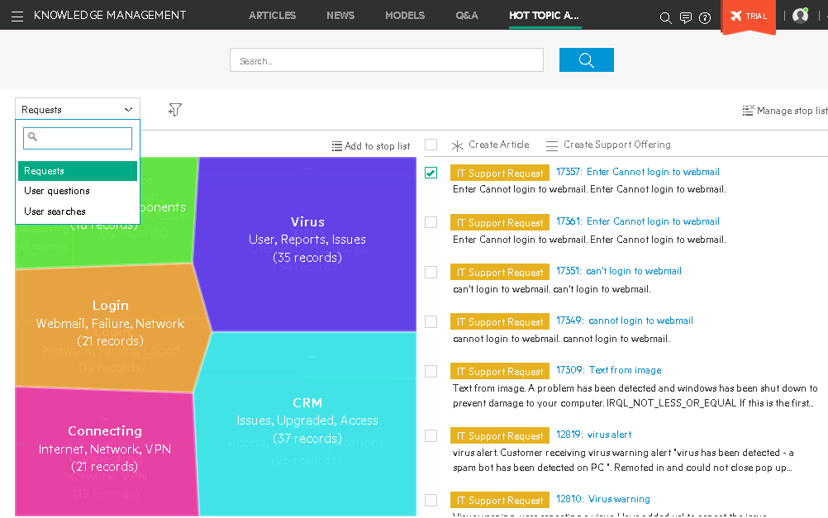
Actionable Hot Topics Analytics
Hot topic maps provide an analysis of unstructured data powered by Big Data analytics
Use cases
Knowledge Management
Analyze hot topic within user portal search, social Q&A, and requests and use to create KM Article content or offering
Problem Management
Analyze hot topics within incidents and use to create Problem records
Survey
Easily understand free text survey comments

Slide 11
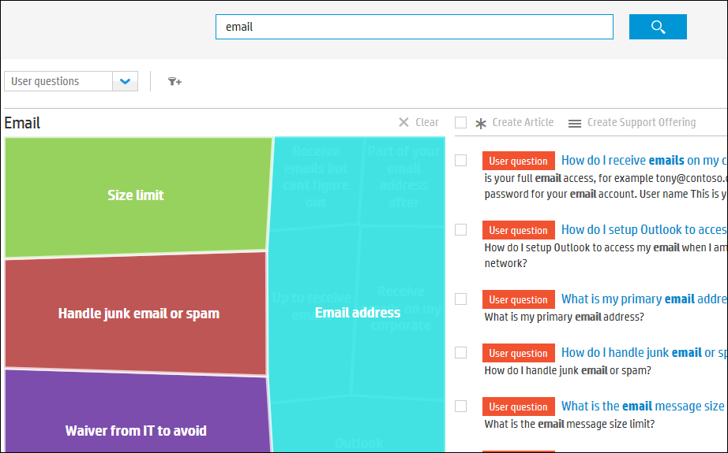
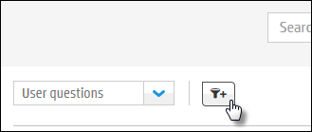
Refine Hot Topic Analytics
Refine the hot topic map by entering search terms.
Further refine hot topic map by source data type:
Requests,
User questions,
User searches

Slide 12
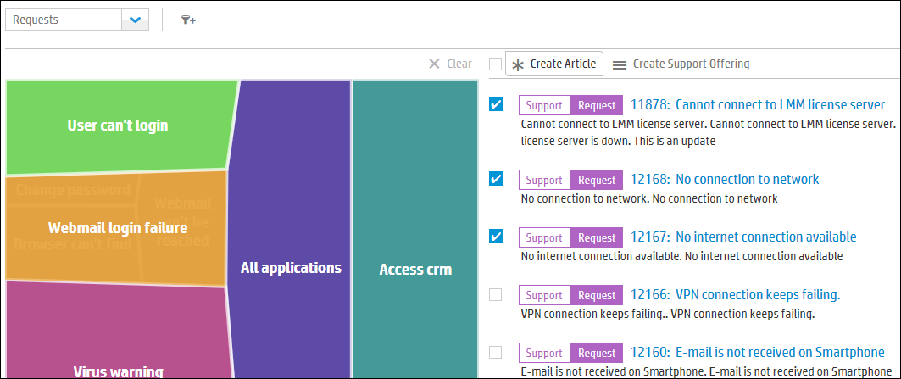
Create content from Hot Topic Analytics
From the Hot Topic Map you can select items on right to then:
Create Article
Create Support Offering

Slide 13
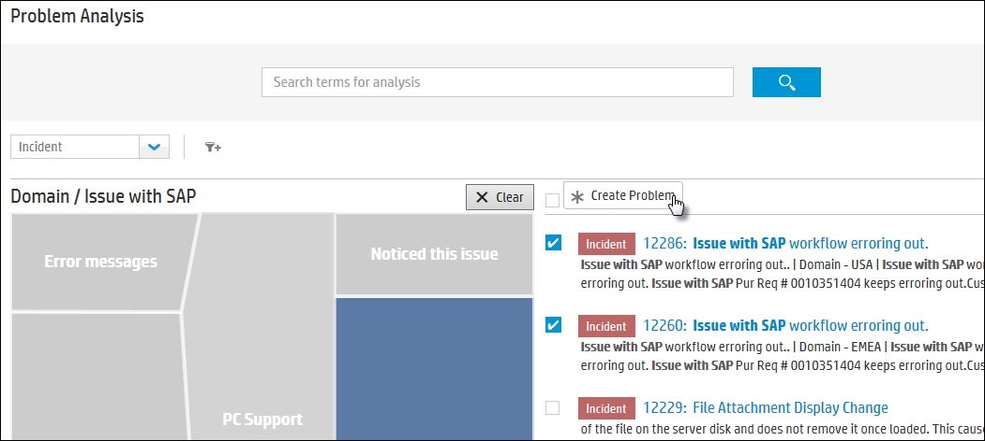
Problem Hot Topic Analytics
Mega Menu > Problem > Hot Topic Analytics
Problem Managers can use Hot Topic Analytics to proactively analyze incidents.
Once a problem is identified, select the incidents and click Create Problem.

Slide 14
Hot Topic Analytics algorithm
Hot topic algorithm
Heat Map
Words
Correlation
Text fields
Title
Description
Solution
Ignore
Email addresses
Single letters
Common & rare words
Stop list words
Only largest topics appear in heat map
Number of topics depends on number of records:
20-50 records - 3 to 4 topics
50-200 records - 10 topics
200-500 records - 20 topics
500-2,000 records - 30 topics
> 2,000 records - 40 topics
Displays number of records in each Topic
Notes:
Hot topics are calculated by an algorithm that takes into account the words that appear in a given set of records (for example, in support requests or in incidents), and finds the topics in those records by looking for correlations between subsets of the words. The calculation takes into account the textual fields of the records (that includes title, description, and solution). The list of topics is calculated by removing extraneous items such as email addresses, single letters, common and rare words and now, as well, the stop list words.
This analytics as you will be ware is driven by the underlying IDOL technology, a component of HAVEN. So the idea here is to make the algorithm more efficient at producing meaningful results. Words like “should” “can” and “how” will appear in many unrelated questions and we have added them to the standard stop list to avoid them affecting the heat map. In a customer environment there may be other words that have the same affect and so we are giving customers the ability to adjust appropriately.
So once the analytics have run - The resulting calculated number of topics depends on the number of records. And only the largest topics are presented in the hot topics map.
The minimum number of records that is used for calculation is 20 so if your sample size is less than 20 no heat map will be generated.
If there are enough records, the resulting topics are displayed in a hot topics map, showing the three or four most significant terms for each topic.
After the calculation, if a certain word is incorrectly or needlessly displayed in the hot topics map, it can be removed by adding it to the stop list.
For those interested in the background detail of how the topics are determined you can see on the right hand side how it works. So for 20-50 records the heat map will display 3-4 topics whilst for more than 2,000 records the heat map will display up to 40 topics.

Slide 15
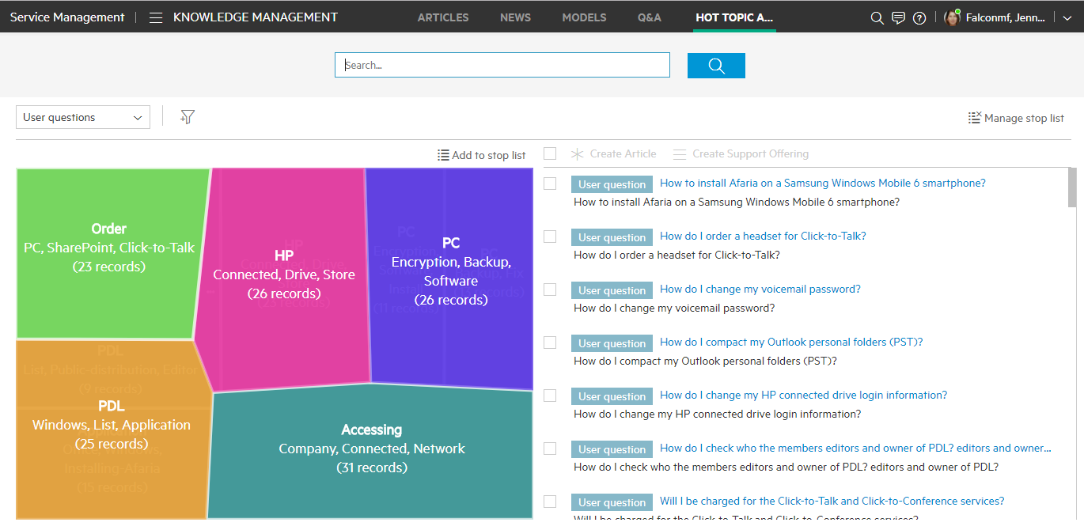
Manage Stop List
Stop List
Manage Stop List
Add to Stop List
Notes:
Each topic shows the number records in that topic
Two options for controlling the stop list:
The add to stop list button allows any user to add words to their own stop list
Whilst the Manage stop list button requires admin access and allows an authorised user to amend the master stop list

Slide 16
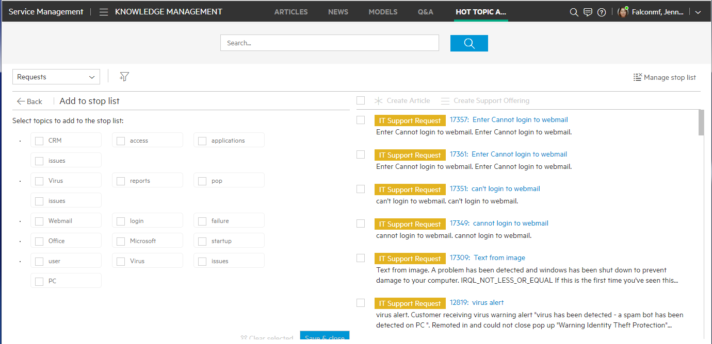
Add words to Stop list
Notes:
When you click on add words to stop list, they are added to a user-defined list that is independent of the language you are entering. This means that this user-defined list may contain words in multiple languages.
So, In the Hot Topic Analytics screen, click on add words to stop list:
A list of words that appear in the analysis for this topic
Select one or more words to add to the stop list.
When you are finished, click to update the stop list and return to the Hot Topic Analytics screen.
The hot topics map is immediately updated to show that the terms are no longer included in the results, and the number of related records is updated as well.

Slide 17
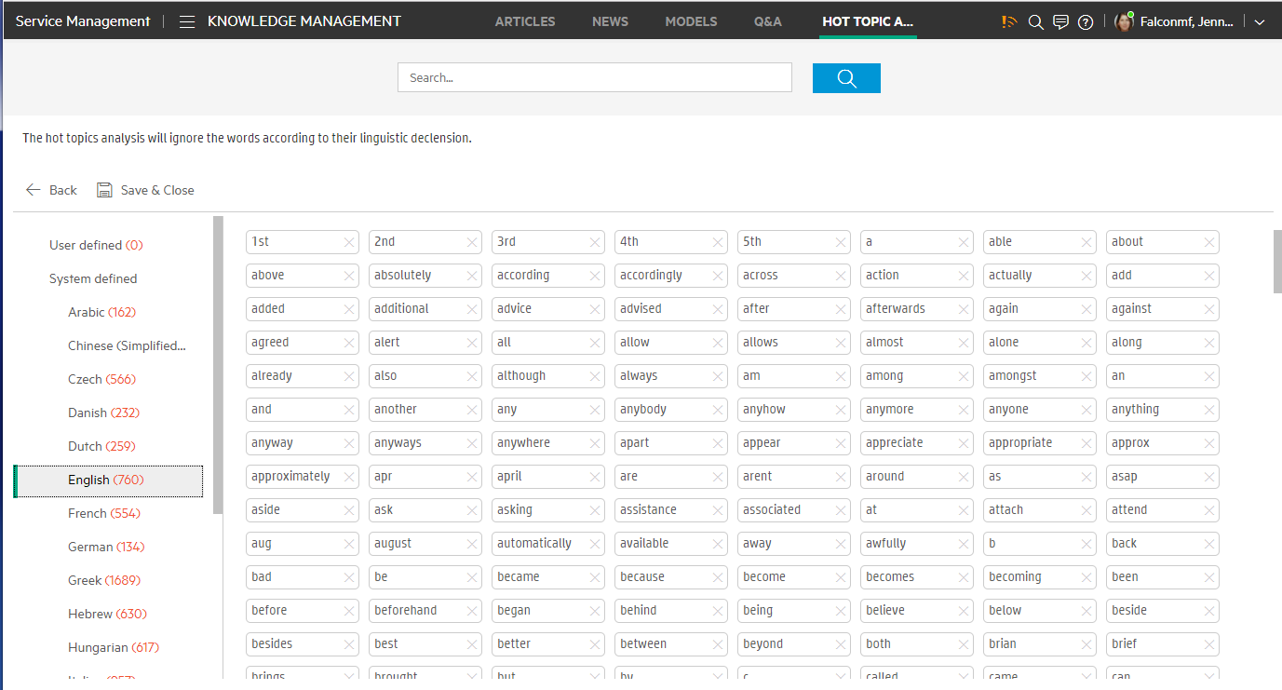
Multi-lingual Stop list
Notes:
As an Admin, when you click on manage the stop list, you can add or delete words from the user-defined list, as well as delete words from the out-of-the-box lists.
When you manage the Stop list this way, words are stored by language
In the Hot Topic Analytics screen, click Manage Stop list, then do one of the following:
To remove a word from either the user-defined stop lists or one of the system-defined lists, select a specific list and click next to the words you want to remove.
To add a word to the stop list, enter a word and click . The word is added to the user-defined list.
To search for a particular word, enter it in the Search field and click

Slide 18
Article Management

Slide 19
Article Management
Manage complete lifecycle of Knowledge Articles
There are two ways to create a new knowledge article:
Manually add an article – create a new knowledge article by clicking New button, or from another online function within the agent interface
Content consisting of: media, images, SlideShare, rich text features
Import one or more articles using the Packaging tool.
Uses the Knowledge Packaging Tool which can be downloaded from KM Import screen
Optional: Create an article retriever plugin to import from another KM system
More on using the packaging tool in the “How to Administer and Configure” SMA-X course

Slide 20
Article Management
 | Creating Knowledge | Using Knowledge
Request | Create an Article from a Request | Link an Article for resolution Link related Articles/News View relevant News View relevant Questions
Incident | Create an Article from an Incident Create a News from an Incident | Link an Article for resolution Link related Articles/News View relevant News
Problem | Create an Article from a Problem Create a News from a Problem | Link related Articles/News View relevant News
Change | Create an Article from a Change Create a News from a Change | Link related Articles/News
Release | Create an Article from a Release Create a News from a Release | Link related Articles/News
Hot Topic Analytics | Create an Article from one or several Requests, User questions, User searches

Slide 21
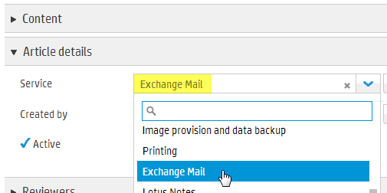
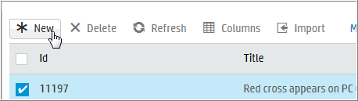
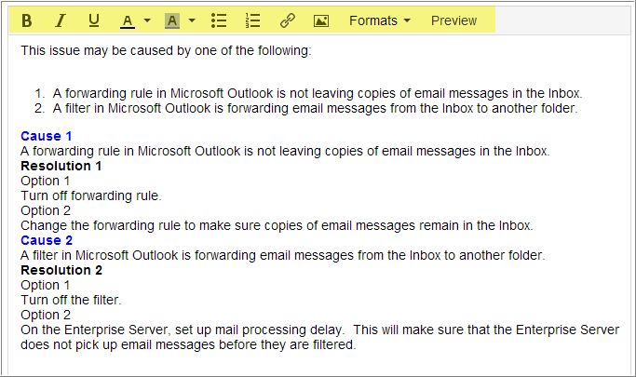
Creating a New Article
Mega Menu > Knowledge > Articles > New
Rich Text editor
Toggle on and Off
Bold, Italics & Underline
Color & Highlight
Bullets & Numbers
Link IT Articles or Catalog offerings
Imbed images
Additional Formats
ESS Preview

Slide 22
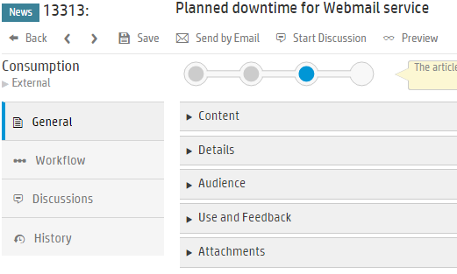
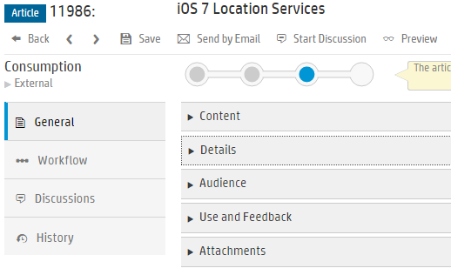
Knowledge Management
Record content

Slide 23
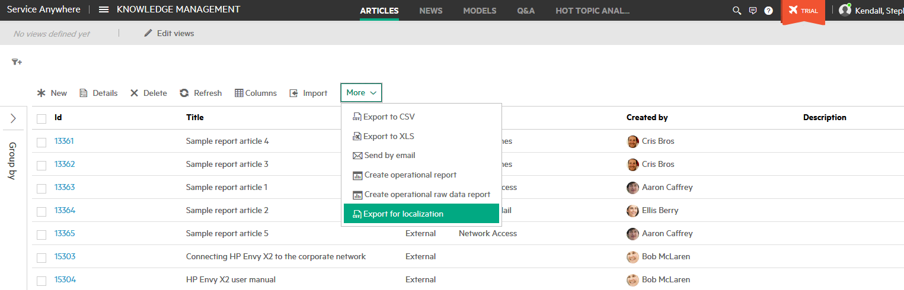
Article localization
Manage a single Article record that can be localized to multiple languages
Multi step process
From Main Menu > Build > Knowledge
Select article to localize
Click on More – Export for localization
Select the languages for localization
CSV created to send off for translation
From Administration > Configuration > Records
Drop down list Article
Import translations
Notes:
The ability to manage Localization in the one knowledge article, allows you to manage the lifecycle of the knowledge in a multilingual environment much more efficiently.
Service Anywhere provides also on the fly translation for non-localized articles.
Having both options allows a customer to decide on the best option for their circumstances and indeed they may chose to use both methods in different scenarios.
The process for localization is:
- Export the article for translation
- A csv file is created that can be sent off to your translation service (or for you to translate in-house)
- A separate csv is created for each language so if you are translating to multiple languages you will have multiple CSVs
- Once translated - Re-import the CSVs
- As you import - You will see the progress of the import.
- At the end of the import the dialog box displays the results, including the number of records successfully imported and the number of failed records.
You can click the Details link to download a report of the failed records. The report displays the error for each failed record in the operation.
Once that step completes the article is now available in each of the translated languages.
And, if the user is logged on in a language that has not been translated they will see the article in the original language.
Be aware that as well as displaying the articles in the users native language Service Anywhere prioritises articles in the user’s native language in the search process.
That is for an Italian speaking user, Italian articles will appear above English articles when they do a search
23

Slide 24
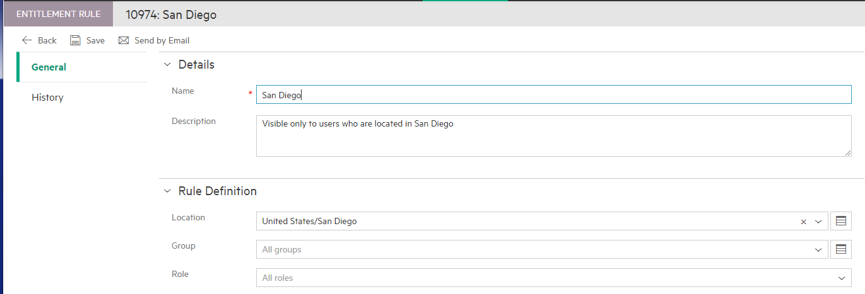
Knowledge Article Audience – Content Visibility
Mega Menu > Administration > People > Entitlement Rules
Articles can be restricted to some users via Entitlement Rules.
An Entitlement Rule can be limited to people in Locations, Groups, and/or Roles.
Entitlement Rules can be used for the Audience for Categories, Service Definitions, Catalog Offerings, Articles, News and Themes.
Set up a new Entitlement Rule.

Slide 25
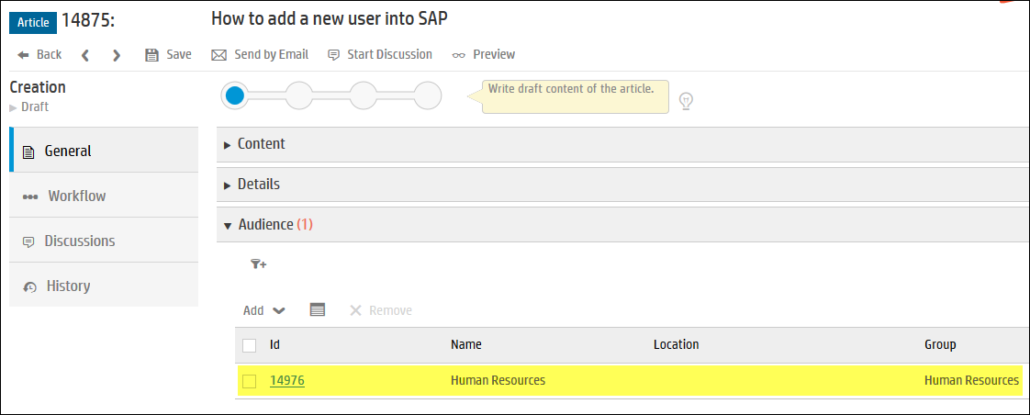
Knowledge Article Audience – Restricting Articles
Mega Menu > Knowledge > Articles
In the Article, set the Audience to the Human Resources entitlement rule.
You can add multiple entitlement rules to an article record.
Only users in the group of Human Resources will be able to see this article

Slide 26
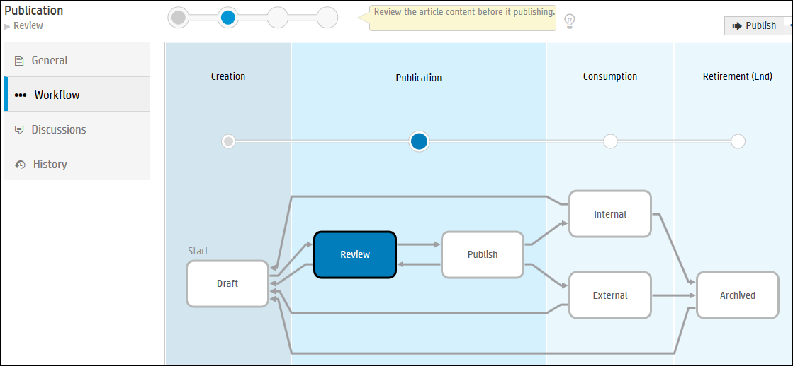
Knowledge Article Workflow
Manual Transitions.
Publish Internal only IT Agents to see.
Publish External Self Service Portal and IT Agents to see.
Approvals can be defined at Governance (global) or Model level or article level

Slide 27
Knowledge Management
Workflow metaphases and phases
Metaphases organize phases into general categories. There are four metaphases in the out-of-the-box knowledge article workflow. The building blocks of the workflow are phases. Phases are the sequential steps in a workflow. Phases ensure that the knowledge article follows an orderly, planned progression from the time you create a knowledge article until the knowledge article is archived. There are six phases in the default knowledge workflow
Creation
When you add a new knowledge article, it enters the workflow at Draft phase by default.
When you perform a mass import of knowledge articles, you can specify the phase for the articles.
Draft phase: Any user with a Knowledge Management role may create or import a knowledge article.
Publication
The Publication metaphase is where an article undergoes review and updating.
Review phase: Any user with a Knowledge Management role may review the draft article and decide whether to publish it or return it to draft status for further editing.
Publish phase: Any user with a Knowledge Management role may publish the knowledge article to an internal audience. Only users with Knowledge Publisher or Knowledge Administrator roles may publish the knowledge article to an external audience
Notes:
Note: When you import (as opposed to create) knowledge articles, you can specify the phase at which to import them

Slide 28
Knowledge Management
Workflow metaphases and phases
Consumption
The Consumption metaphase is where the article is released to its intended audience, either external (visible through the Self-Service Portal) or internal (in Service Anywhere).
Internal / External phase: The knowledge article becomes visible to an internal or external audience.
Retirement
The Retirement metaphase is the final stage in the workflow. When an article is no longer relevant, it is either archived or sent back to the beginning of the workflow for further updating.
Archived phase: Any user with a Knowledge Management role may specify that the knowledge article has reached the end of its lifecycle and archives it

Slide 29
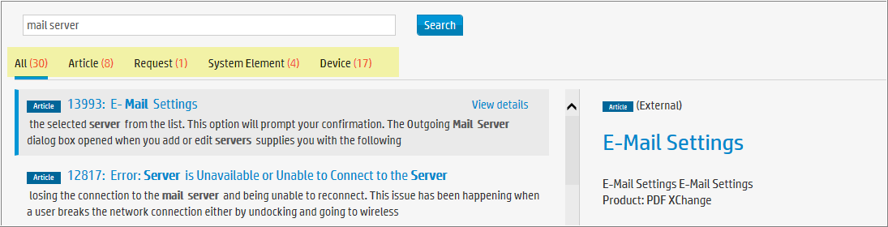
Indexing
Indexing on regular intervals (approx every 5 minutes)
When uploading articles, expect up to 5 minute delay before searching
Global Search
If you search for one or more words, “or” is inferred. For example, if you type "mail server" the search looks for "mail server" or "mail" or "server".
Results are sorted by relevancy so results with “mail server” will be shown first.
Search display a maximum of 30 results – like first page results in Google

Slide 30
IT News / Hot News

Slide 31
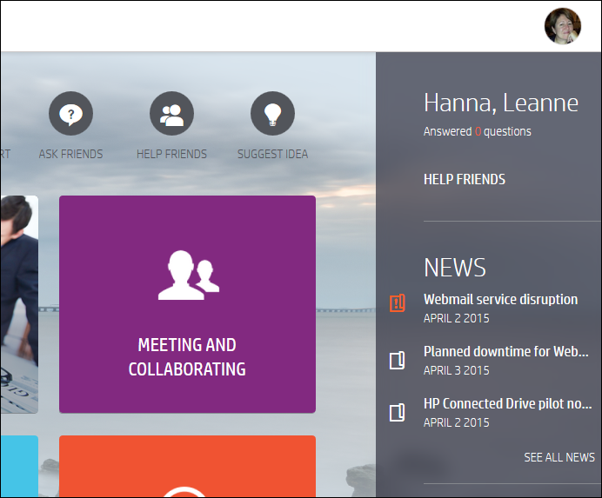
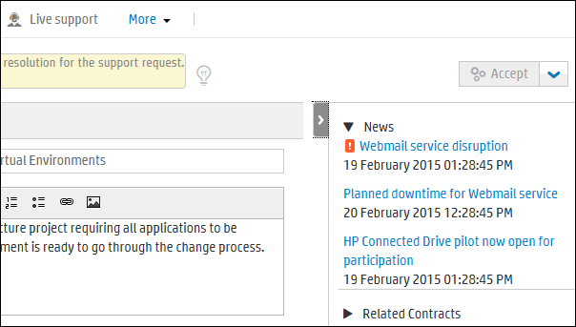
IT News
Hot News relevant for Business users and IT Agents
Self Service Targeted News
Receive news via Self-Service Portal on web and mobile
Segmented news by your location/group/role entitlements
See news relevant to your service and support context
IT Agents also see News within the IT Agent UI

Slide 32
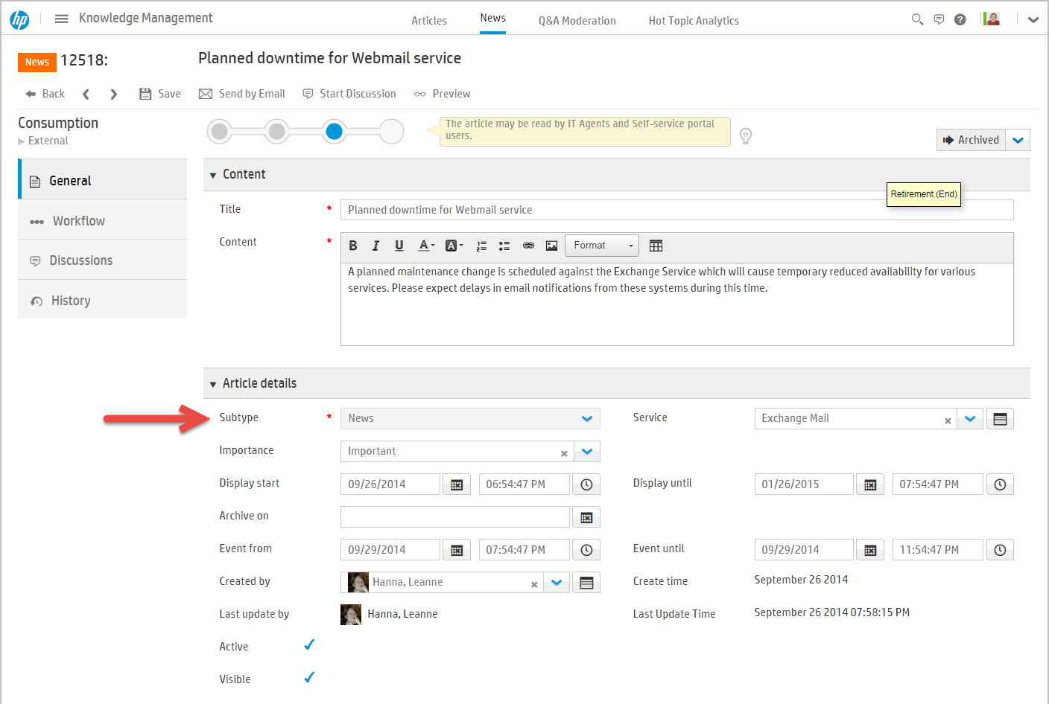
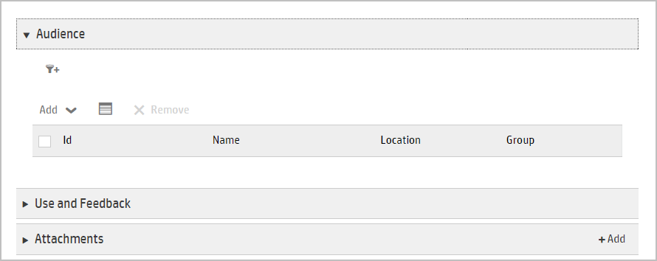
Manually adding News Articles
Mega Menu > Knowledge > News
Push news to users via Self-Service Portal on web and mobile:
Segment news by location and group entitlements.
See news relevant to service and support context in the Self Service Portal and IT Agent interface.
Create news from Incident, Change, Release, or Problem
Use same workflow and entitlement rules as Articles

Slide 33
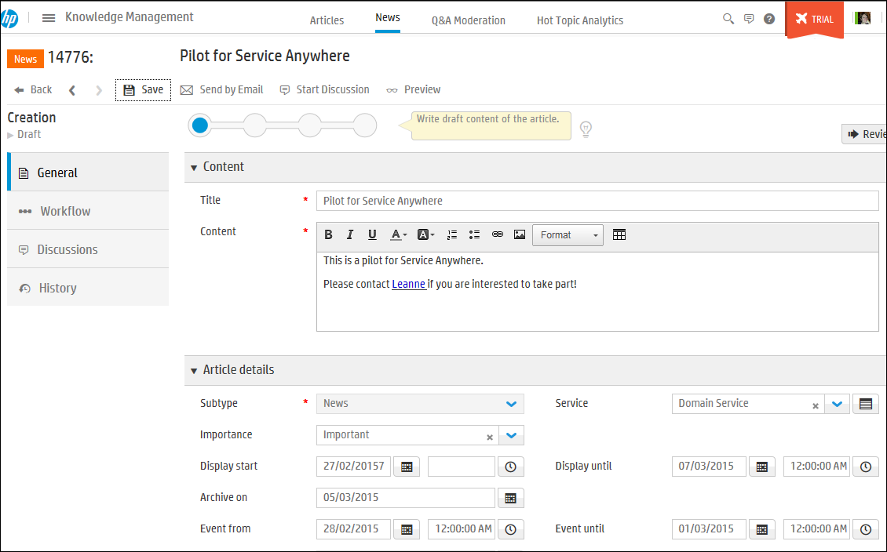
Manually adding News Articles
Mega Menu > Knowledge > News > New
Title and Content
Display start and end control when News will be active (displayed to users)
Important news will show at top of news list
Archive on date sets when News is archived

Slide 34
Q&A Moderation

Slide 35
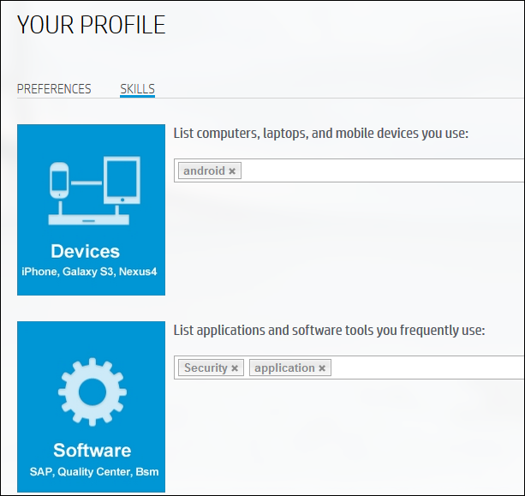
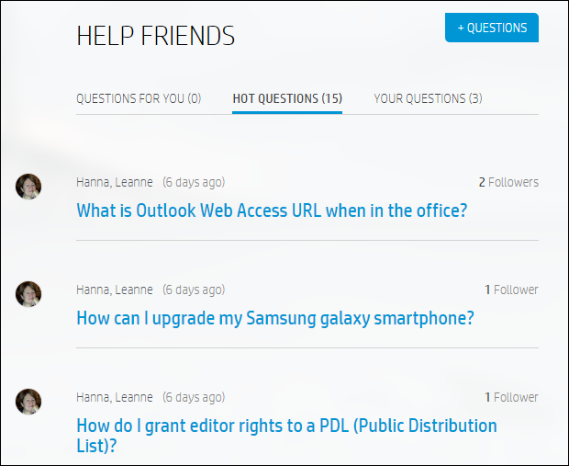
Ask Friends/Help Friends
Engaging and fun; IT still controls
Business Community
Users can define skills of expertise
Profiles are further enhanced each time a user answers a question or works on a certain problem ticket
Search Based Matching
Forum posts are matched with Expert Profiles
Experts are proactively sent requests to help out
Notes:
Utilizing the knowledge across the organization; puts the business into a single conversation

Slide 36
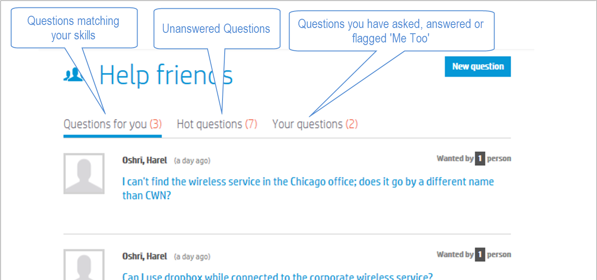
Q&A Self-Service Portal Views
Questions for you
Matches your profile skillset with questions asked by your peers
Hot questions
Unanswered questions
Your questions
Questions you’ve asked, answered or currently follow (me too)

Slide 37
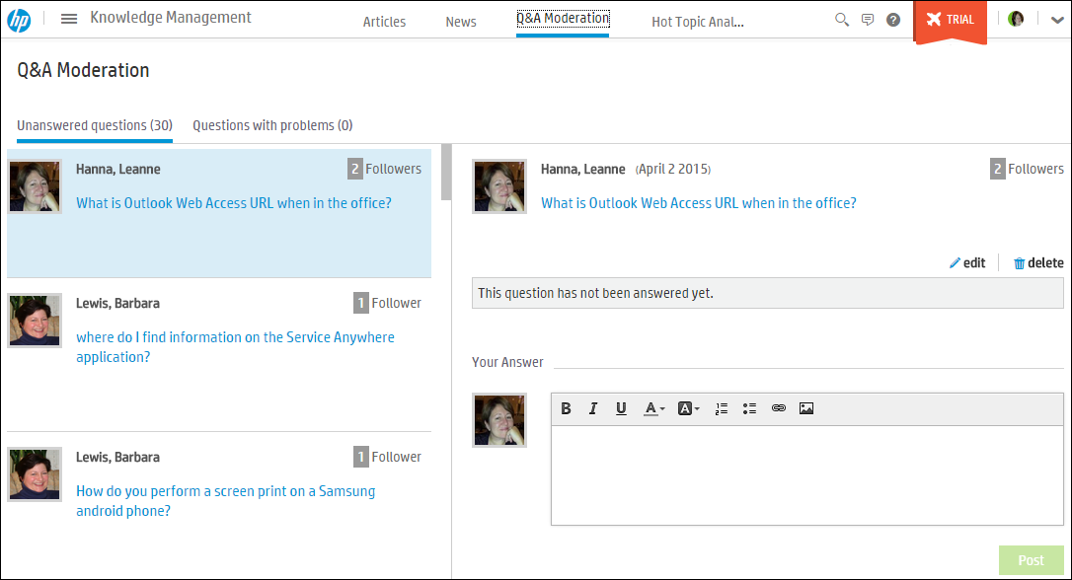
Q&A Moderation
Manage Questions and Answers from users
Self-service users post questions and assist each other.
New IT articles can be created from exiting posts.
From Q&A moderation you can:
Fix questions
Edit or delete questions and answers
Post new answers

Slide 38
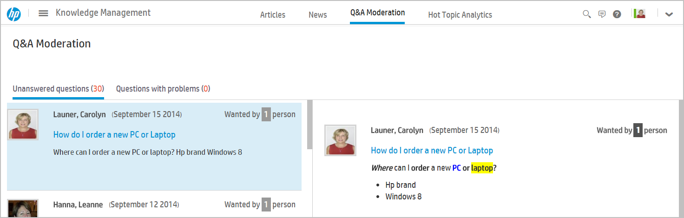
Q&A Moderation Views
Questions with problems
Questions flagged as having problems
Sorted descending by highest number of reported problems
Edit and delete questions
Edit and delete answers
Unanswered Questions
Sorted descending by highest number of requesters
Edit, delete or answer

Slide 39
Exercise
Create a News article that is relevant for 2 days for the Sharepoint service notifying of a new Office Events Sharepoint site. Publish it external.
Verify that amy.lopezmf can see your News article

